Slide 1
Exception Handling in Java
Instructor :Prashant Mishra
BIAS Bhimtal

Slide 2
Exception Handling in Java
The Exception Handling in Java is one of the powerful mechanism to handle the runtime errors so that normal flow of the application can be maintained.
In this lecture, we will learn about Java exceptions, its type and the difference between checked and unchecked exceptions.

Slide 3
What is Exception in Java
Dictionary Meaning: Exception is an abnormal condition.
In Java, an exception is an event that disrupts the normal flow of the program. It is an object which is thrown at runtime.
What is Exception Handling
Exception Handling is a mechanism to handle runtime errors such as ClassNotFoundException, IOException, SQLException, RemoteException, etc.

Slide 4
Advantage of Exception Handling
The core advantage of exception handling is to maintain the normal flow of the application. An exception normally disrupts the normal flow of the application that is why we use exception handling. Let's take a scenario:
Suppose there are 10 statements in your program and there occurs an exception at statement 5, the rest of the code will not be executed i.e. statement 6 to 10 will not be executed. If we perform exception handling, the rest of the statement will be executed. That is why we use exception handling in Java.
statement 1;
statement 2;
statement 3;
statement 4;
statement 5;//exception occurs
statement 6;
statement 7;
statement 8;
statement 9;
statement 10;

Slide 5
Hierarchy of Java Exception classes
The java.lang.Throwable class is the root class of Java Exception hierarchy which is inherited by two subclasses: Exception and Error. A hierarchy of Java Exception classes are given below:

Slide 6
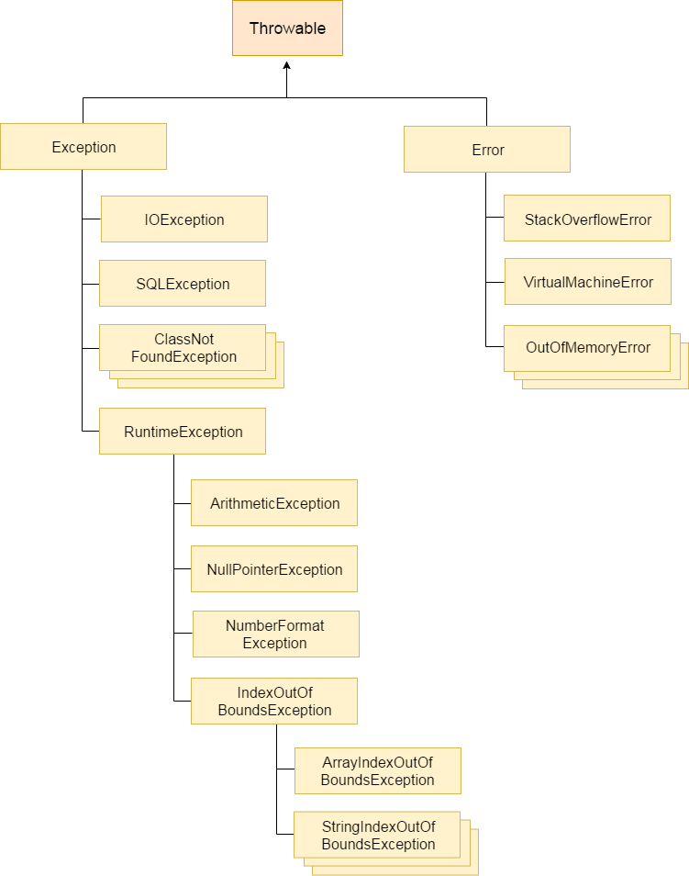

Slide 7
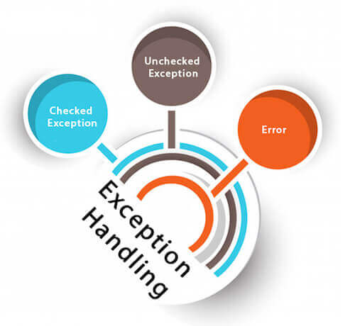
Types of Java Exceptions
There are mainly two types of exceptions: checked and unchecked. Here, an error is considered as the unchecked exception. According to Oracle, there are three types of exceptions:
Checked Exception
Unchecked Exception
Error

Slide 8
Difference between Checked and Unchecked Exceptions
1) Checked Exception
The classes which directly inherit Throwable class except RuntimeException and Error are known as checked exceptions e.g. IOException, SQLException etc. Checked exceptions are checked at compile-time.
2) Unchecked Exception
The classes which inherit RuntimeException are known as unchecked exceptions e.g. ArithmeticException, NullPointerException, ArrayIndexOutOfBoundsException etc. Unchecked exceptions are not checked at compile-time, but they are checked at runtime.
3) Error
Error is irrecoverable e.g. OutOfMemoryError, VirtualMachineError, AssertionError etc.

Slide 9
Checked Exception | Unchecked Exception
Checked exceptions occur at compile time. | Unchecked exceptions occur at runtime.
A checked exception is checked by the compiler. | The compiler does not check these type of exception.
These types of exception can be handled at the time of compilation. | These types of exceptions cannot be a catch or handle at the time of compilation, because they get generated by the mistakes in the program.
They are the sub-class of the exception class. | They are runtime exceptions and hence are not a part of the Exception class.
Here, the JVM needs the exception to catch and handle. | Here, the JVM does not require the exception to catch and handle.
Examples of Checked exceptions:File Not Found Exception No Such Field Exception Interrupted Exception No Such Method Exception Class Not Found Exception | Examples of Unchecked Exceptions:No Such Element Exception Undeclared Throwable Exception Empty Stack Exception Arithmetic Exception Null Pointer Exception Array Index Out of Bounds Exception Security Exception

Slide 10
Java Exception Keywords
There are 5 keywords which are used in handling exceptions in Java.
Keyword | Description
try | The "try" keyword is used to specify a block where we should place exception code. The try block must be followed by either catch or finally. It means, we can't use try block alone.
catch | The "catch" block is used to handle the exception. It must be preceded by try block which means we can't use catch block alone. It can be followed by finally block later.
finally | The "finally" block is used to execute the important code of the program. It is executed whether an exception is handled or not.
throw | The "throw" keyword is used to throw an exception.
throws | The "throws" keyword is used to declare exceptions. It doesn't throw an exception. It specifies that there may occur an exception in the method. It is always used with method signature.

Slide 11
public class JavaExceptionExample{
public static void main(String args[]){
int data=100/1;
System.out.println(data);
//rest code of the program
System.out.println("rest of the code...");
}
}
Output:
100
rest of the code...
Press any key to continue . . .

Slide 12
public class JavaExceptionExample{
public static void main(String args[]){
try{
//code that may raise exception
int data=100/1;
System.out.println(data);
}catch(ArithmeticException e){System.out.println(e);}
//rest code of the program
System.out.println("rest of the code...");
}
}
Output:
100
rest of the code...
Press any key to continue . . .

Slide 13
Java Exception Handling Example : program without Exception Handling
public class JavaExceptionExample{
public static void main(String args[])
{
int data=100/0;
System.out.println(data);
System.out.println("rest of the code...");
}
}
Exception in thread "main" java.lang.ArithmeticException: / by zero
at JavaExceptionExample.main(JavaExceptionExample.java:4)
Press any key to continue . . .

Slide 14
Java Exception Handling Example
public class JavaExceptionExample{
public static void main(String args[]){
try{
//code that may raise exception
int data=100/0;
System.out.println(data);
}catch(ArithmeticException e){System.out.println(e);}
//rest code of the program
System.out.println("rest of the code...");
}
}
java.lang.ArithmeticException: / by zero
rest of the code...
Press any key to continue . . .

Slide 15
public class JavaExceptionExample{
public static void main(String args[]){
try{
//code that may raise exception
int data=100/0;
}catch(ArithmeticException e){System.out.println(e);}
//rest code of the program
System.out.println("rest of the code...");
System.out.println(data);
}
}
C:\Users\admin\Desktop\JavaExceptionExample.java:10: error: cannot find symbol
System.out.println(data);
^
symbol: variable data
location: class JavaExceptionExample
1 error
Tool completed with exit code 1

Slide 16
Common Scenarios of Java Exceptions
There are given some scenarios where unchecked exceptions may occur. They are as follows:
1) A scenario where ArithmeticException occurs
If we divide any number by zero, there occurs an ArithmeticException.
int a=50/0;//ArithmeticException
2) A scenario where NullPointerException occurs
If we have a null value in any variable, performing any operation on the variable throws a NullPointerException.
String s=null;
System.out.println(s.length());//NullPointerException

Slide 17
3) A scenario where NumberFormatException occurs
The wrong formatting of any value may occur NumberFormatException. Suppose I have a string variable that has characters, converting this variable into digit will occur NumberFormatException.
String s="abc";
int i=Integer.parseInt(s);//NumberFormatException
4) A scenario where ArrayIndexOutOfBoundsException occurs
If you are inserting any value in the wrong index, it would result in ArrayIndexOutOfBoundsException as shown below:
int a[]=new int[5];
a[10]=50; //ArrayIndexOutOfBoundsException

Slide 18
Java try-catch block
Java try block is used to enclose the code that might throw an exception. It must be used within the method.
If an exception occurs at the particular statement of try block, the rest of the block code will not execute. So, it is recommended not to keeping the code in try block that will not throw an exception.
Java try block must be followed by either catch or finally block.

Slide 19
Syntax of Java try-catch
try{
//code that may throw an exception
}catch(Exception_class_Name ref){}

Slide 20
Syntax of try-finally block
try{
//code that may throw an exception
}finally{}

Slide 21
java catch block
Java catch block is used to handle the Exception by declaring the type of exception within the parameter. The declared exception must be the parent class exception ( i.e., Exception) or the generated exception type. However, the good approach is to declare the generated type of exception.
The catch block must be used after the try block only. You can use multiple catch block with a single try block.

Slide 22
public class TryCatchExample1 {
public static void main(String[] args) {
int data=50/0; //may throw exception
System.out.println("rest of the code");
}
}
Output:
Exception in thread "main" java.lang.ArithmeticException: / by zero

Slide 23
Solution by exception handling
public class TryCatchExample2 {
public static void main(String[] args) {
try
{
int data=50/0; //may throw exception
}
//handling the exception
catch(ArithmeticException e)
{
System.out.println(e);
}
System.out.println("rest of the code");
}
}
Output:
java.lang.ArithmeticException: / by zero rest of the code

Slide 24
Example 3 In this example, we also kept the code in a try block that will not throw an exception.
public class TryCatchExample3 {
public static void main(String[] args) {
try
{
int data=50/0; //may throw exception
// if exception occurs, the remaining statement will not exceute
System.out.println("rest of the code");
}
// handling the exception
catch(ArithmeticException e)
{
System.out.println(e);
}
}
}
Output:
java.lang.ArithmeticException: / by zero

Slide 25
Example 4 Here, we handle the exception using the parent class exception.
public class TryCatchExample4 {
public static void main(String[] args) {
try
{
int data=50/0; //may throw exception
}
// handling the exception by using Exception class
catch(Exception e)
{
System.out.println(e);
}
System.out.println("rest of the code");
}
}
Output:
java.lang.ArithmeticException: / by zero rest of the code

Slide 26
Example 5 Let's see an example to print a custom message on exception.
public class TryCatchExample5 {
public static void main(String[] args) {
try
{
int data=50/0; //may throw exception
}
// handling the exception
catch(Exception e)
{
// displaying the custom message
System.out.println("Can't divided by zero");
}
}
}
Output:
Can't divided by zero

Slide 27
Example 6 Let's see an example to resolve the exception in a catch block.
public class TryCatchExample6 {
public static void main(String[] args) {
int i=50;
int j=0;
int data;
try
{
data=i/j; //may throw exception
} // handling the exception
catch(Exception e)
{
// resolving the exception in catch block
System.out.println(i/(j+2));
}
}
}
Output:
25

Slide 28
Example 7 In this example, along with try block, we also enclose exception code in a catch block.
public class TryCatchExample7 {
public static void main(String[] args) {
try
{
int data1=50/0; //may throw exception
} // handling the exception
catch(Exception e)
{
// generating the exception in catch block
int data2=50/0; //may throw exception
}
System.out.println("rest of the code");
}
}
Output:
Exception in thread "main" java.lang.ArithmeticException: / by zero

Slide 29
public class TryCatchExample7a {
public static void main(String[] args) {
try
{
int data1=50/0; //may throw exception
}
// handling the exception
catch(Exception e)
{
try
{// generating the exception in catch block
int data2=50/0; //may throw exception
}
catch(Exception e1){
}
}
System.out.println("rest of the code");
}
}
rest of the code
Press any key to continue . . .

Slide 30
Example 8
In this example, we handle the generated exception (Arithmetic Exception) with a different type of exception class (ArrayIndexOutOfBoundsException).
public class TryCatchExample8 {
public static void main(String[] args) {
try
{
int data=50/0; //may throw exception
}
// try to handle the ArithmeticException using ArrayIndexOutOfBoundsException
catch(ArrayIndexOutOfBoundsException e)
{
System.out.println(e);
}
System.out.println("rest of the code");
}
}
Exception in thread "main" java.lang.ArithmeticException: / by zero

Slide 31
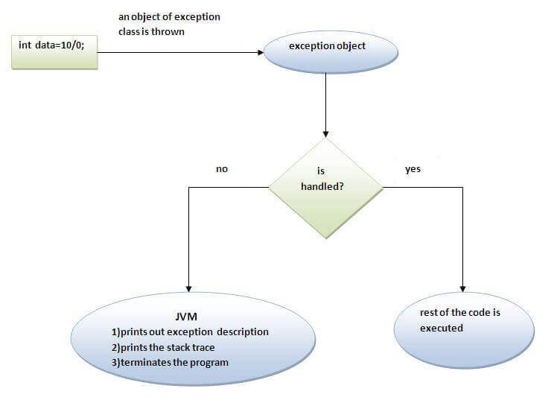
Internal working of java try-catch block

Slide 32
The JVM firstly checks whether the exception is handled or not. If exception is not handled, JVM provides a default exception handler that performs the following tasks:
Prints out exception description.
Prints the stack trace (Hierarchy of methods where the exception occurred).
Causes the program to terminate.
But if exception is handled by the application programmer, normal flow of the application is maintained i.e. rest of the code is executed.

Slide 33
Java catch multiple exceptions

Slide 34
Java Multi-catch block
A try block can be followed by one or more catch blocks. Each catch block must contain a different exception handler. So, if you have to perform different tasks at the occurrence of different exceptions, use java multi-catch block.
At a time only one exception occurs and at a time only one catch block is executed.
All catch blocks must be ordered from most specific to most general, i.e. catch for ArithmeticException must come before catch for Exception.

Slide 35
public class MultipleCatchBlock1 {
public static void main(String[] args) {
try{
int a[]=new int[5];
a[5]=30/0;
}
catch(ArithmeticException e)
{
System.out.println("Arithmetic Exception occurs");
}
catch(ArrayIndexOutOfBoundsException e)
{
System.out.println("ArrayIndexOutOfBounds Exception occurs");
}
catch(Exception e)
{
System.out.println("Parent Exception occurs");
}
System.out.println("rest of the code");
}
}
Output:
Arithmetic Exception occurs rest of the code

Slide 36
In this example, try block contains two exceptions. But at a time only one exception occurs and its corresponding catch block is invoked.
public class MultipleCatchBlock3 {
public static void main(String[] args) {
try{
int a[]=new int[5];
a[5]=30/0;
System.out.println(a[10]);
}
catch(ArithmeticException e)
{
System.out.println("Arithmetic Exception occurs");
}
catch(ArrayIndexOutOfBoundsException e)
{
System.out.println("ArrayIndexOutOfBounds Exception occurs");
}
catch(Exception e)
{
System.out.println("Parent Exception occurs");
}
System.out.println("rest of the code");
}
}
Output:
Arithmetic Exception occurs
rest of the code

Slide 37
In this example, we generate NullPointerException, but didn't provide the corresponding exception type. In such case, the catch block containing the parent exception class Exception will invoked.
public class MultipleCatchBlock4 {
public static void main(String[] args) {
try{
String s=null;
System.out.println(s.length());
}
catch(ArithmeticException e)
{
System.out.println("Arithmetic Exception occurs");
}
catch(ArrayIndexOutOfBoundsException e)
{
System.out.println("ArrayIndexOutOfBounds Exception occurs");
}
catch(Exception e)
{
System.out.println("Parent Exception occurs");
}
System.out.println("rest of the code");
}
}
Output:
Parent Exception occurs
rest of the code

Slide 38
an example, to handle the exception without maintaining the order of exceptions (i.e. from most specific to most general)
class MultipleCatchBlock5{
public static void main(String args[]){
try{
int a[]=new int[5];
a[5]=30/0;
}
catch(Exception e){System.out.println("common task completed");}
catch(ArithmeticException e){System.out.println("task1 is completed");}
catch(ArrayIndexOutOfBoundsException e){System.out.println("task 2 completed");}
System.out.println("rest of the code...");
}
}
Output:
Compile-time error

Slide 39
Java Nested try block
The try block within a try block is known as nested try block in java.
Why use nested try block
Sometimes a situation may arise where a part of a block may cause one error and the entire block itself may cause another error. In such cases, exception handlers have to be nested.

Slide 40
Syntax:
....
try
{
statement 1;
statement 2;
try
{
statement 1;
statement 2;
}
catch(Exception e)
{
}
}
catch(Exception e)
{
}
....

Slide 41
class Excep6{
public static void main(String args[]){
try{
try{
System.out.println("going to divide");
int b =39/0;
} catch(ArithmeticException e) { System.out.println(e); }
try{
int a[]=new int[5];
a[5]=4;
}catch(ArrayIndexOutOfBoundsException e){System.out.println(e);}
System.out.println("other statement”);
}
catch(Exception e)
{
System.out.println("handeled");
}
System.out.println("normal flow..");
}
}
Output:
going to divide
java.lang.ArithmeticException: / by zero
java.lang.ArrayIndexOutOfBoundsException: 5
other statement
normal flow..
Press any key to continue . . .

Slide 42
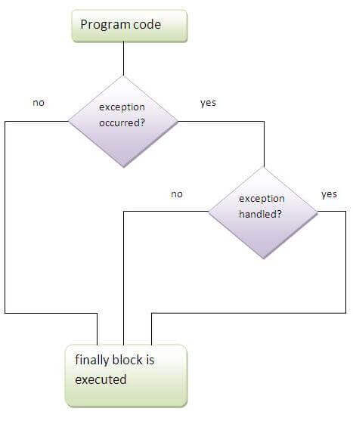
Java finally block
Java finally block is a block that is used to execute important code such as closing connection, stream etc.
Java finally block is always executed whether exception is handled or not.
Java finally block follows try or catch block.
Why use java finally
Finally block in java can be used to put "cleanup" code such as closing a file, closing connection etc.
If you don't handle exception, before terminating the program, JVM executes finally block(if any).

Slide 43
Case 1: the java finally example where exception doesn't occur.
class TestFinallyBlock{
public static void main(String args[]){
try{
int data=25/5;
System.out.println(data);
}
catch(NullPointerException e){System.out.println(e);}
finally{System.out.println("finally block is always executed");}
System.out.println("rest of the code...");
}
}
Output:5
finally block is always executed
rest of the code...

Slide 44
Case 2: the java finally example where exception occurs and not handled.
class TestFinallyBlock1{
public static void main(String args[]){
try{
int data=25/0;
System.out.println(data);
}
catch(NullPointerException e){System.out.println(e);}
finally{System.out.println("finally block is always executed");}
System.out.println("rest of the code...");
}
}
Output: finally block is always executed
Exception in thread main java.lang.ArithmeticException:/ by zero

Slide 45
Case 3: the java finally example where exception occurs and handled.
public class TestFinallyBlock2{
public static void main(String args[]){
try{
int data=25/0;
System.out.println(data);
}
catch(ArithmeticException e){System.out.println(e);}
finally{System.out.println("finally block is always executed");}
System.out.println("rest of the code...");
}
}
Output:Exception in thread main java.lang.ArithmeticException:/ by zero
finally block is always executed
rest of the code...

Slide 46
Rule: For each try block there can be zero or more catch blocks, but only one finally block.
The finally block will not be executed if program exits(either by calling System.exit() or by causing a fatal error that causes the process to abort).

Slide 47
Java throw exception
Java throw keyword
The Java throw keyword is used to explicitly throw an exception.
We can throw either checked or unchecked exception in java by throw keyword. The throw keyword is mainly used to throw custom exception.
The syntax of java throw keyword is given below.
throw exception;
example
throw new IOException("sorry device error”);

Slide 48
java throw keyword example
In this example, If the age is less than 18, we are throwing the ArithmeticException otherwise print a message welcome to vote.
public class TestThrow1{
static void validate(int age){
if(age<18)
throw new ArithmeticException("not valid");
else
System.out.println("welcome to vote");
}
public static void main(String args[]){
validate(13);
System.out.println("rest of the code...");
}
}
Output:
Exception in thread main java.lang.ArithmeticException:not valid

Slide 49
Java throws keyword
The Java throws keyword is used to declare an exception. It gives an information to the programmer that there may occur an exception so it is better for the programmer to provide the exception handling code so that normal flow can be maintained.
Syntax of java throws
return_type method_name() throws exception_class_name{
//method code
}

Slide 50
Which exception should be declared
Ans) checked exception only, because:
unchecked Exception: under your control so correct your code.
error: beyond your control e.g. you are unable to do anything if there occurs VirtualMachineError or StackOverflowError.
Advantage of Java throws keyword
Now Checked Exception can be propagated (forwarded in call stack).
It provides information to the caller of the method about the exception.

Slide 51
Difference between throw and throws in Java
No. | throw | throws
1) | Java throw keyword is used to explicitly throw an exception. | Java throws keyword is used to declare an exception.
2) | Checked exception cannot be propagated using throw only. | Checked exception can be propagated with throws.
3) | Throw is followed by an instance. | Throws is followed by class.
4) | Throw is used within the method. | Throws is used with the method signature.
5) | You cannot throw multiple exceptions. | You can declare multiple exceptions e.g. public void method()throws IOException,SQLException.

Slide 52
Difference between final, finally and finalize
No. | final | finally | finalize
1) | Final is used to apply restrictions on class, method and variable. Final class can't be inherited, final method can't be overridden and final variable value can't be changed. | Finally is used to place important code, it will be executed whether exception is handled or not. | Finalize is used to perform clean up processing just before object is garbage collected.
2) | Final is a keyword. | Finally is a block. | Finalize is a method.

